Slide 1
Studies of TDMI Analysis based on Simulation of IF Neurons
Kai Chen Jan. 2018

Slide 2
Paradigm of simulation
Poisson Driving
Poisson Driving
Conductance
Neuron 1
Spikes
Conductance
Neuron 2
Spikes
Synaptic Current
Synaptic Current

Slide 3
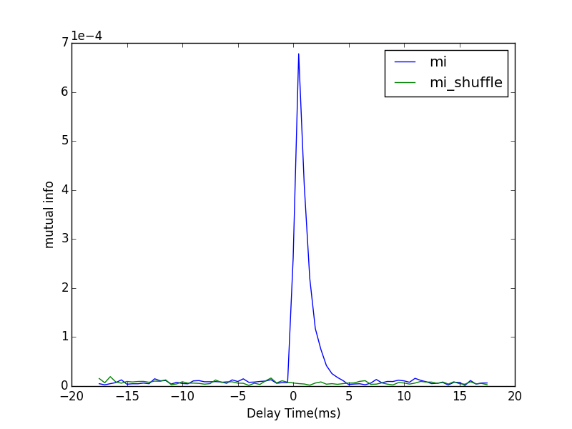
Sample Figure
The peak lying on the positive side of the graph indicates the same direction of neuronal information as the physical connection does.
dt | 0.5 ms
#bins | 10
Poisson Rate | 0.15kHz
Forward Strength | 0.05
Synaptic Strength | 0.005
T | 5 mins

Slide 4
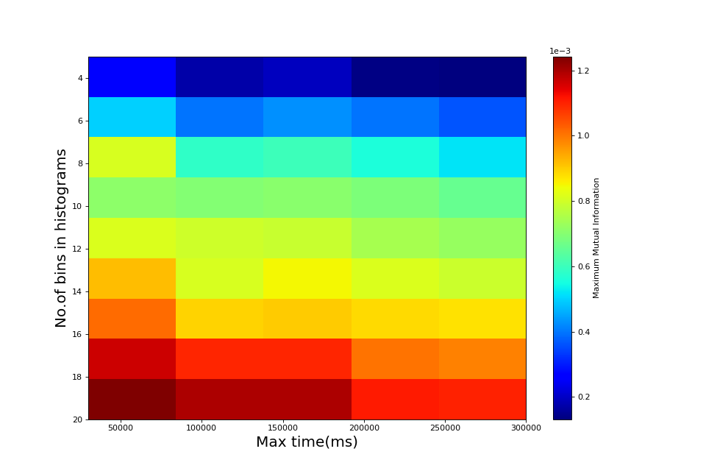
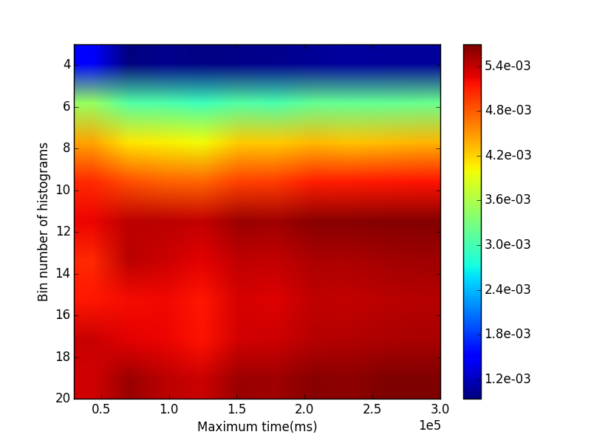
Mutual information calculation
Treated time series of LFP as WSS signal.
Neglect the autocovariance length of LFP.
dt | 0.5 ms
#bins | 10
Poisson Rate | 0.15kHz
Forward Strength | 0.05
Synaptic Strength | 0.005
dt = 0.5 ms

Slide 5
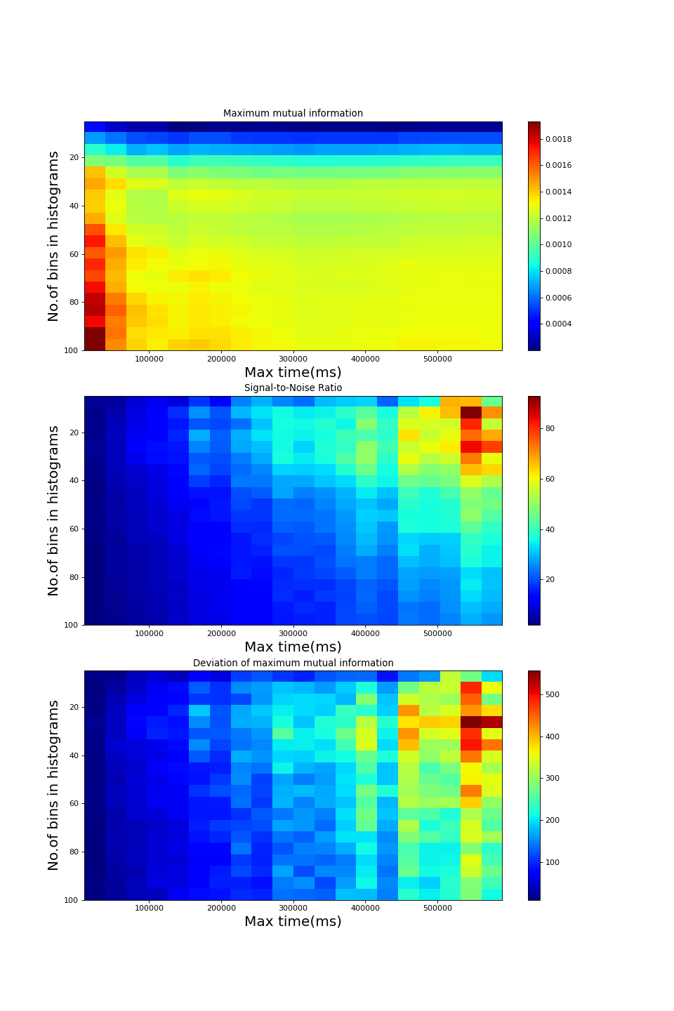
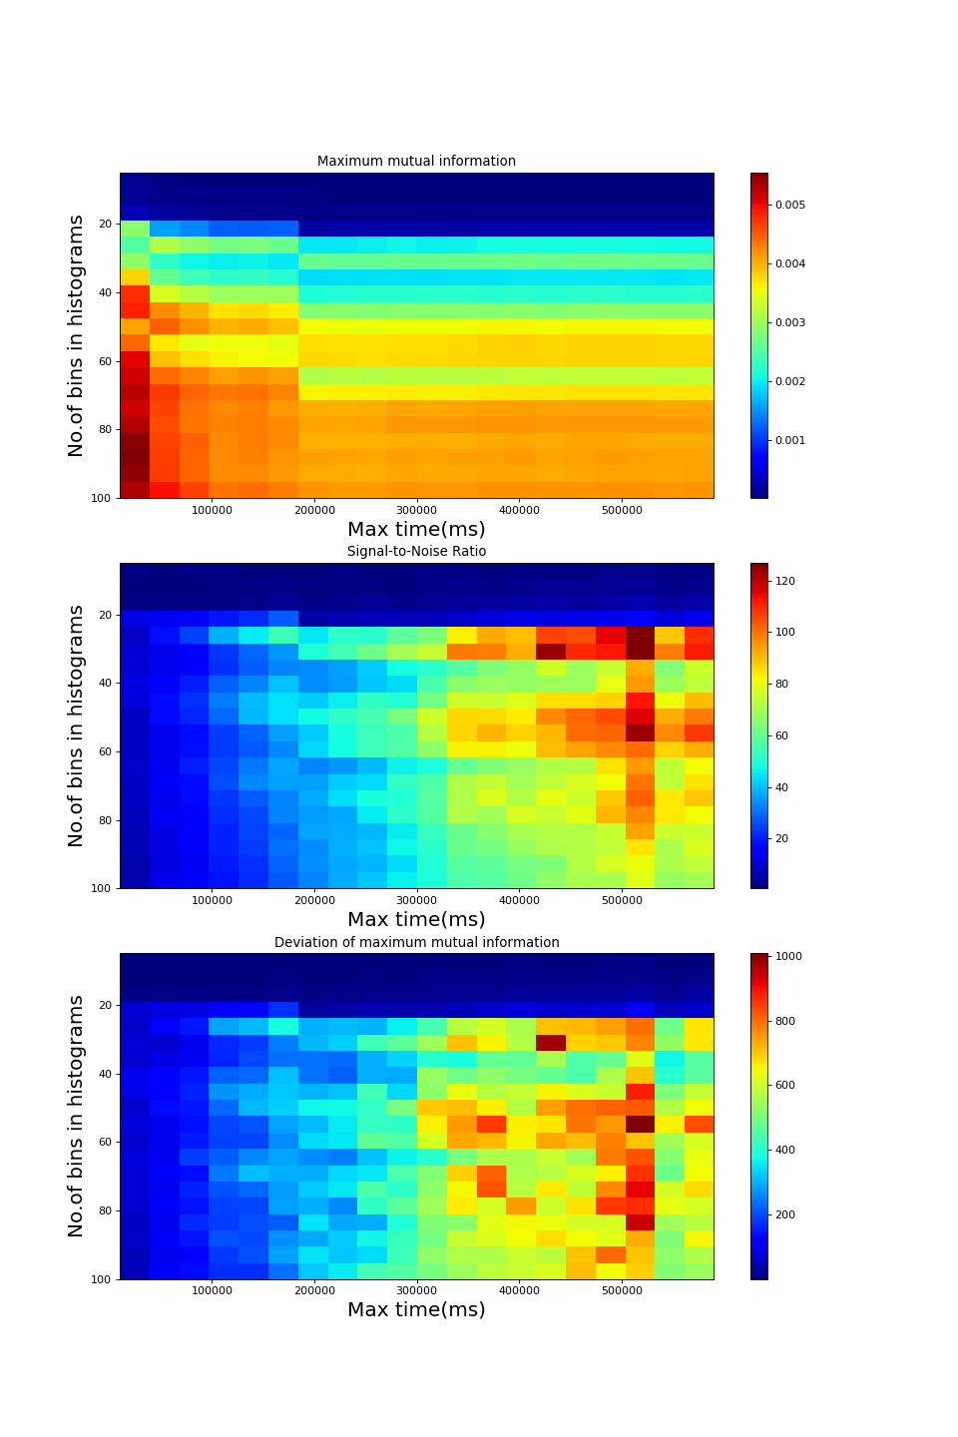
Direct method
dt | 0.5 ms
#bins | 10
T | 10 mins
S = 0.015
S = 0.075

Slide 6
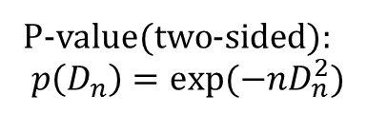
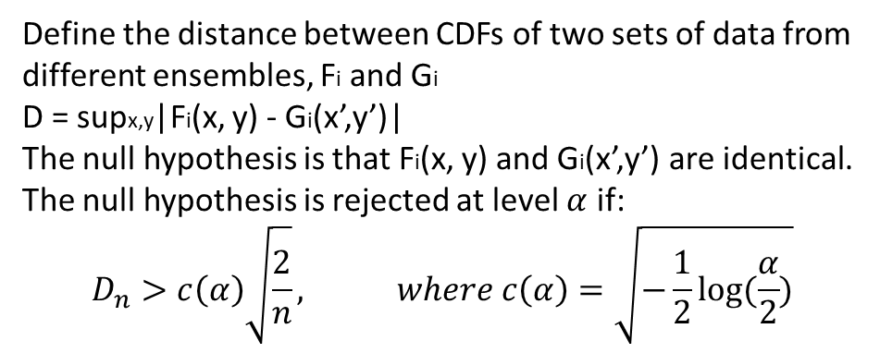
Similarity of joint probability distribution function between different ensembles
Bivariate Two-sample Kolmogorov–Smirnov Test
P-value(two-sided):
$$p\left(D_{n}\right)=exp⁡(−nD_{n}^{2})$$
X: Spike Train
Y: Current
P(x,y): joint distribution density function
Fi(x,y): cumulative distribution density function(CDF)
Define the distance between CDFs of two sets of data from different ensembles, Fi and Gi
D = supx,y|Fi(x, y) - Gi(x’,y’)|
The null hypothesis is that Fi(x, y) and Gi(x’,y’) are identical.
The null hypothesis is rejected at level $α$ if:
$$D_{n}>c\left(α\right)\sqrt{\frac{2}{n}}, where c\left(α\right)=\sqrt{−\frac{1}{2}log⁡(\frac{α}{2})}$$
F1(x,y) = Pr(X < x & Y < y)
F2(x,y) = Pr(X > x & Y < y)
F3(x,y) = Pr(X < x & Y > y)
F4(x,y) = Pr(X > x & Y > y)

Slide 7
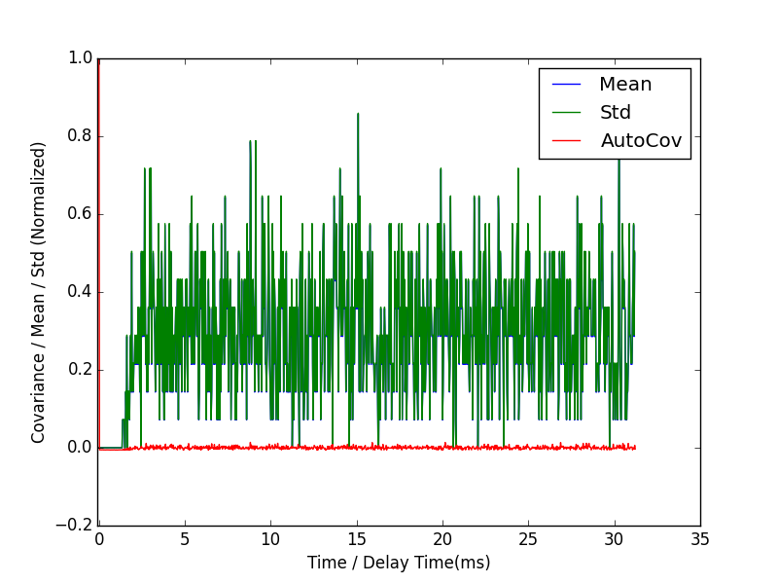
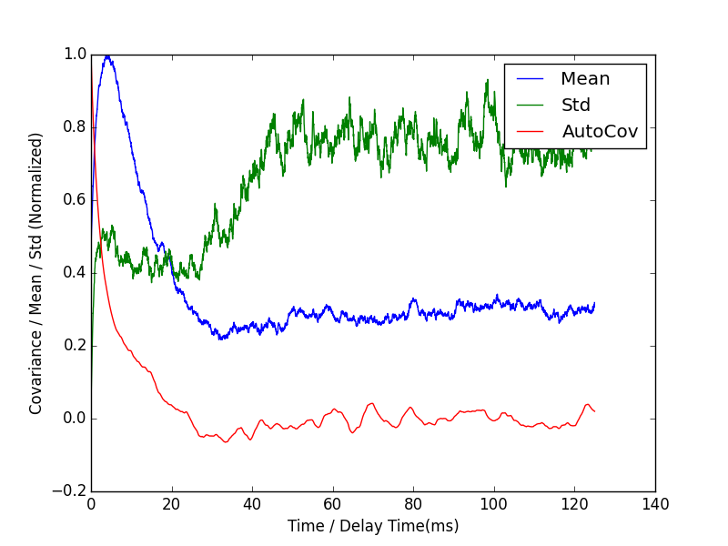
Details in mutual info measurements
S = 0.0050
Autocovariance of spike train of Neuron 1
Autocovariance of LFP of Neuron 1

Slide 8
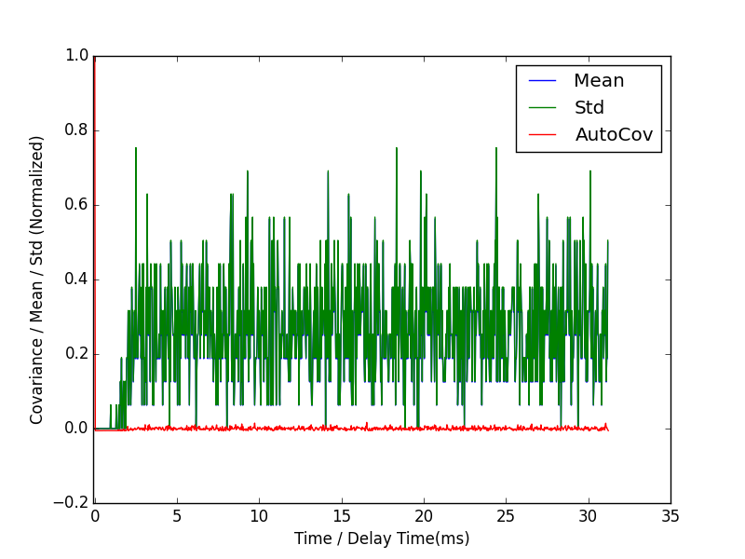
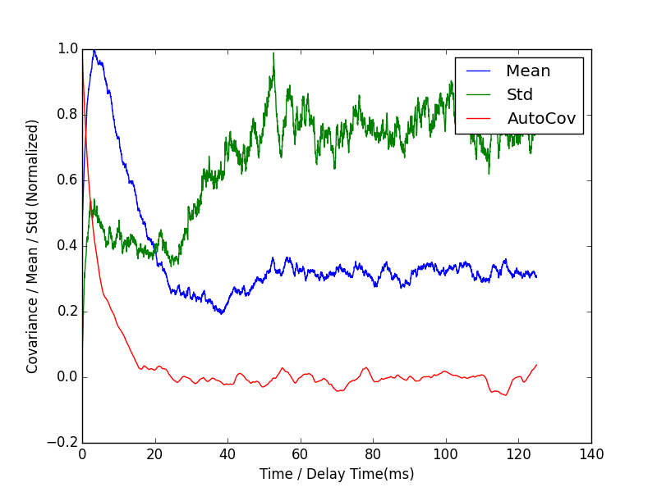
Details in mutual info measurements
S = 0.0145
Autocovariance of spike train of Neuron 1
Autocovariance of LFP of Neuron 1

Slide 9
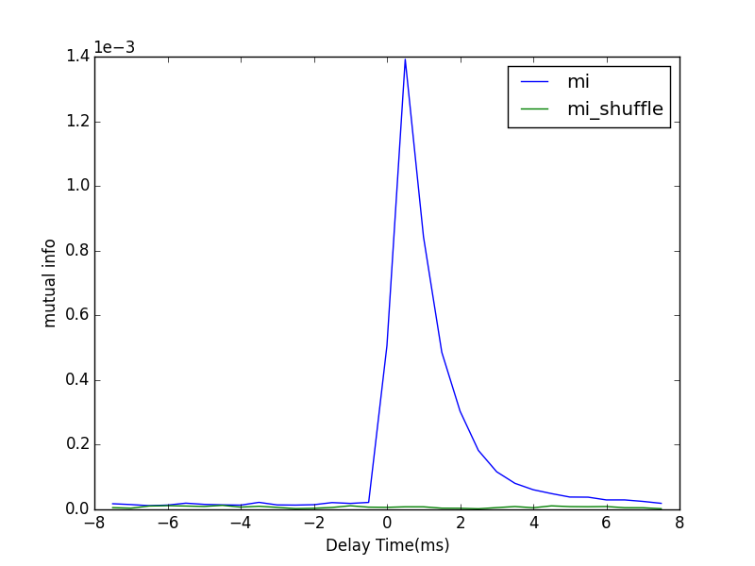
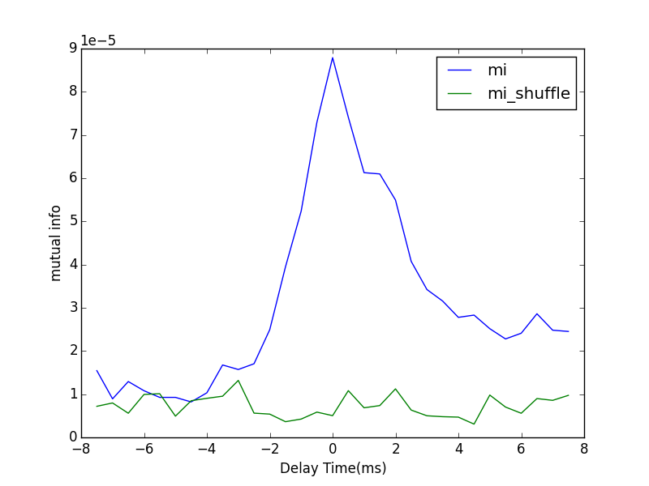
Mono-direction
Poisson Rate | 1.5 kHz
S | 0.005
F | 0.005
dt | 0.5 ms
#bins | 20
T | 10 mins
From 1 to 2
From 2 to 1

Slide 10
Neuronal Interaction layout
Poisson Driving
Poisson Driving
Conductance
Neuron 1
Spikes
Conductance
Neuron 2
Spikes
Correlated!
Synaptic Current
Synaptic Current
Synchronized?
?

Slide 11
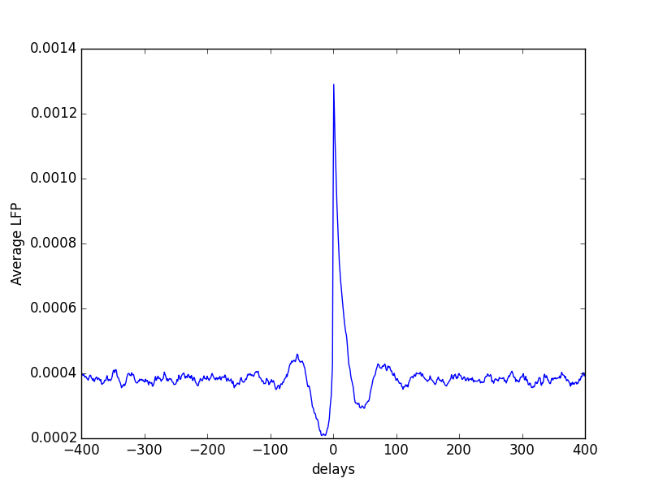
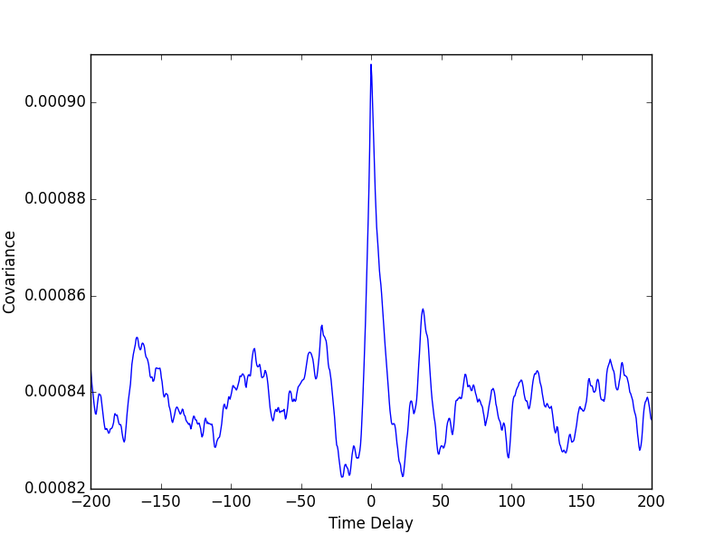
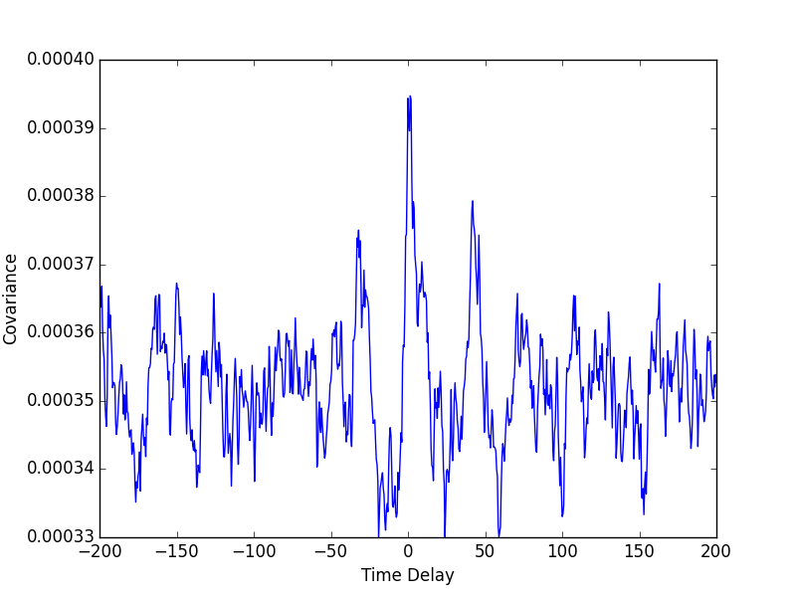
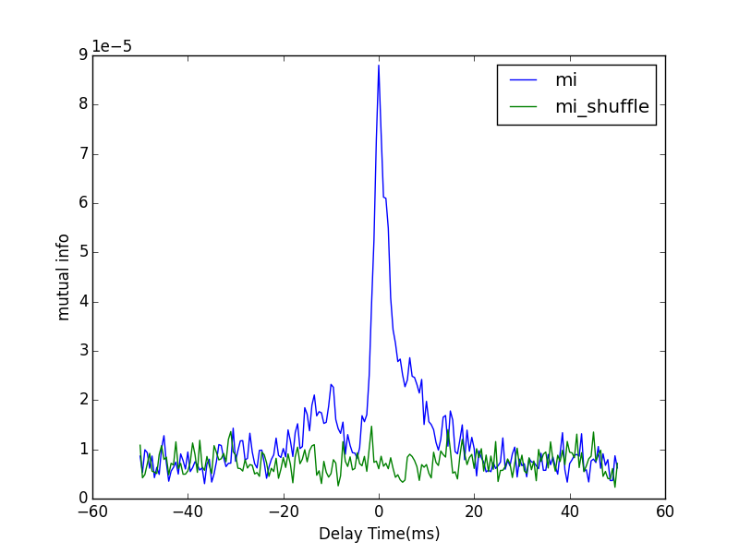
Poisson Rate | 1.5 kHz | dt | 0.5ms
S | 0.005 | #bins | 20
F | 0.005 | T | 10mins
Covariance
Covariance
Spike 2
to
Current 2
Current 2
to
Current 1
Covariance
Spike 2
to
Current 1
Mutual info
Spike 2
to
Current 1

Slide 12
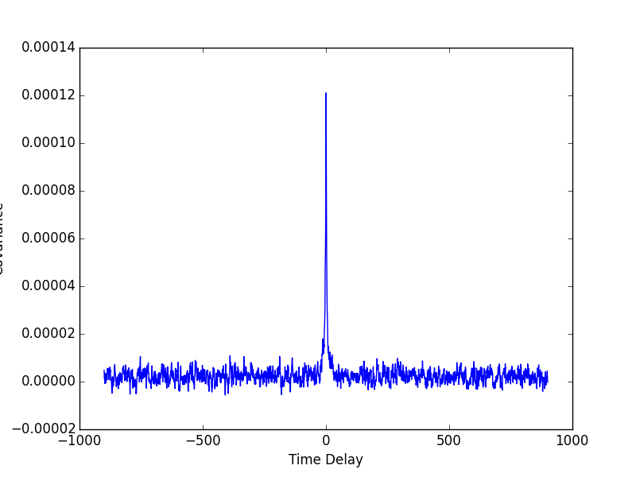
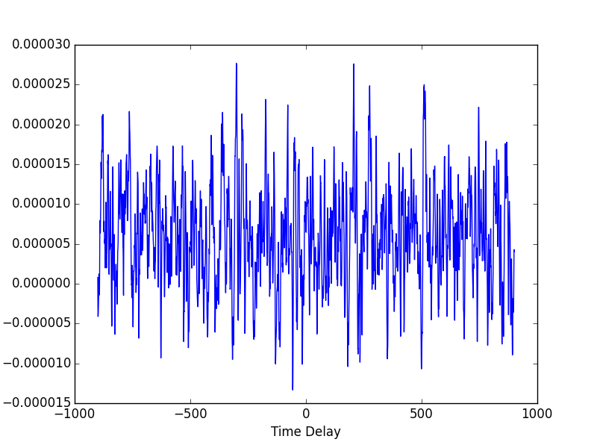
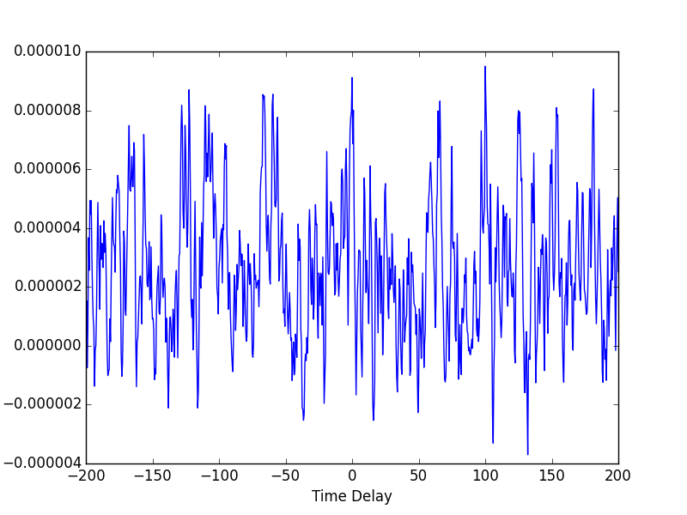
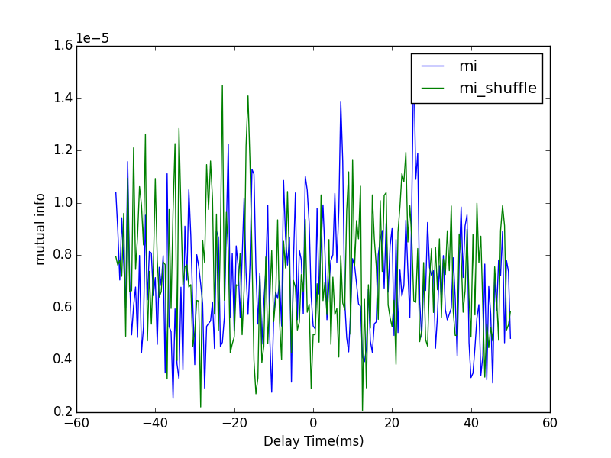
Poisson Rate | 0.1 kHz | dt | 0.5ms
S | 0.005 | #bins | 30
F | 0.030 | T | 10mins
Covariance
Covariance
Spike 2
to
Current 2
Current 2
to
Current 1
Covariance
Spike 2
to
Current 1
Mutual info
Spike 2
to
Current 1

Slide 13
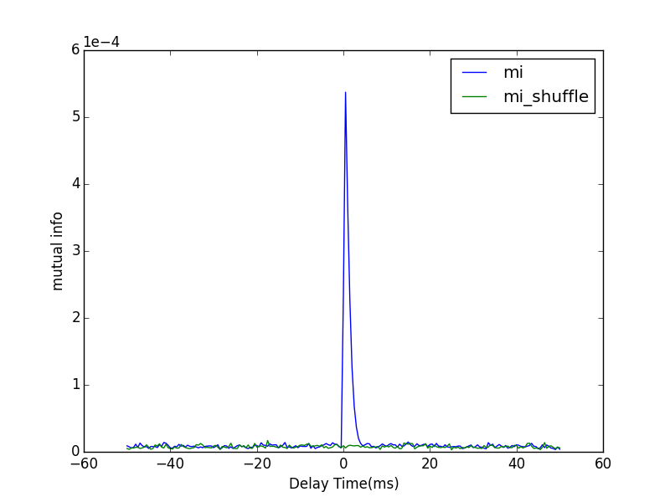
Poisson Rate | 0.1 kHz | dt | 0.5ms
S | 0.005 | #bins | 30
F | 0.030 | T | 10mins

Slide 14
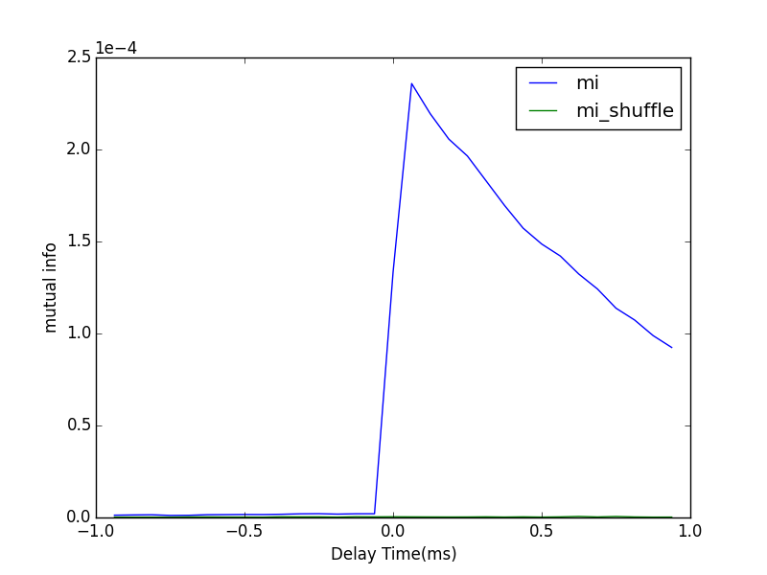
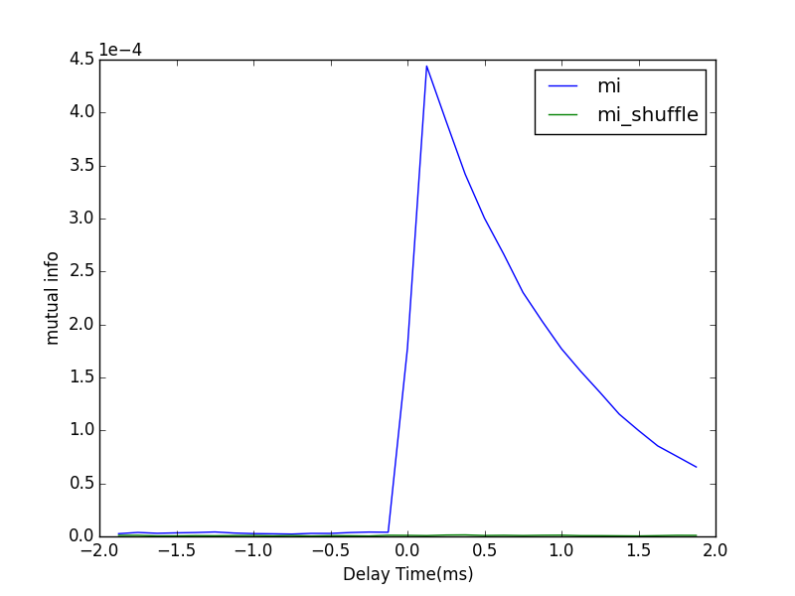
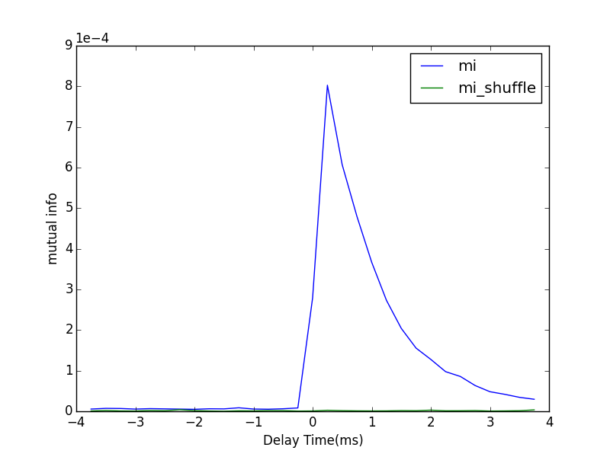
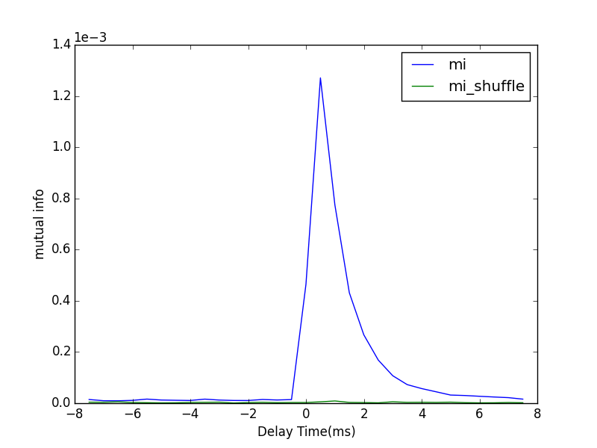
Different Timing Steps
0.0625ms
0.125ms
Poisson Rate | 1.5 kHz
S | 0.005
F | 0.005
#bins | 20
T | 59.5 s
Direct Method
0.25ms
0.5ms

Slide 15
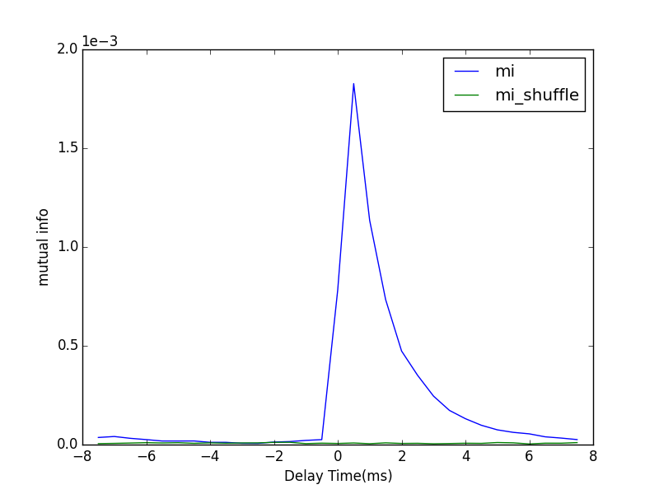
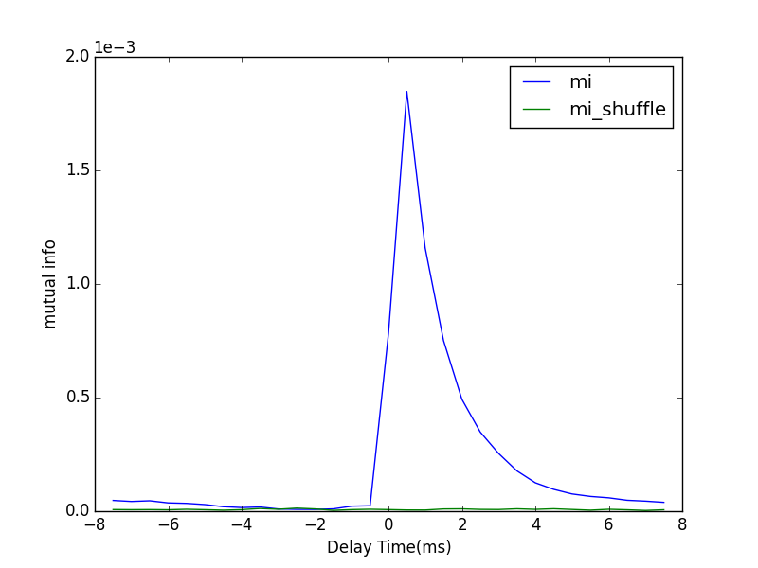
Bi-direction
Poisson Driving Rate | 1.5 kHz
Synaptic Strength | 0.005
Feedforward Strength | 0.005
From 1 to 2
From 2 to 1
dt = 0.5 ms
#bins = 20
T = 10 mins

Slide 16
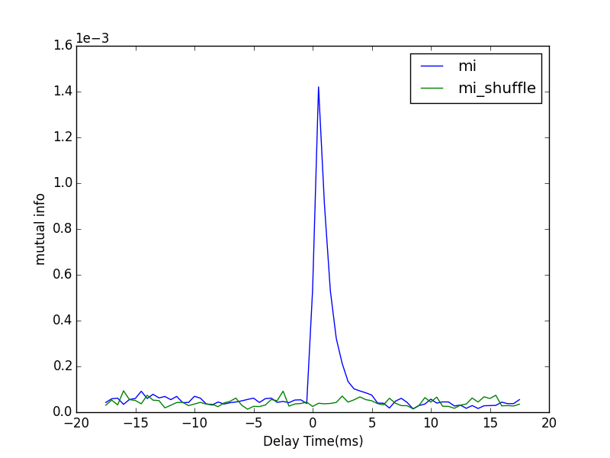
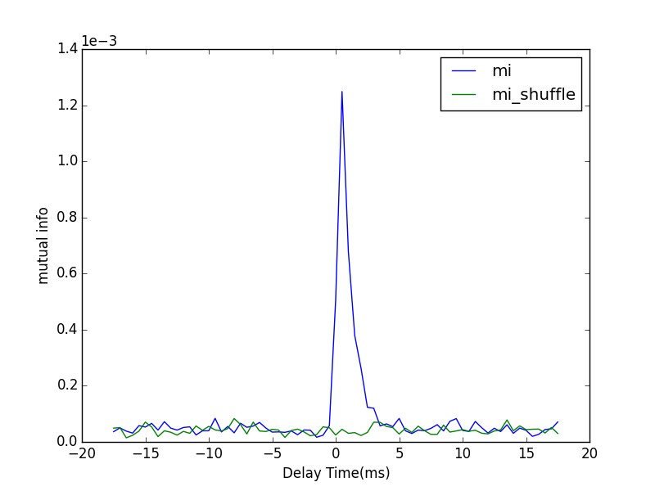
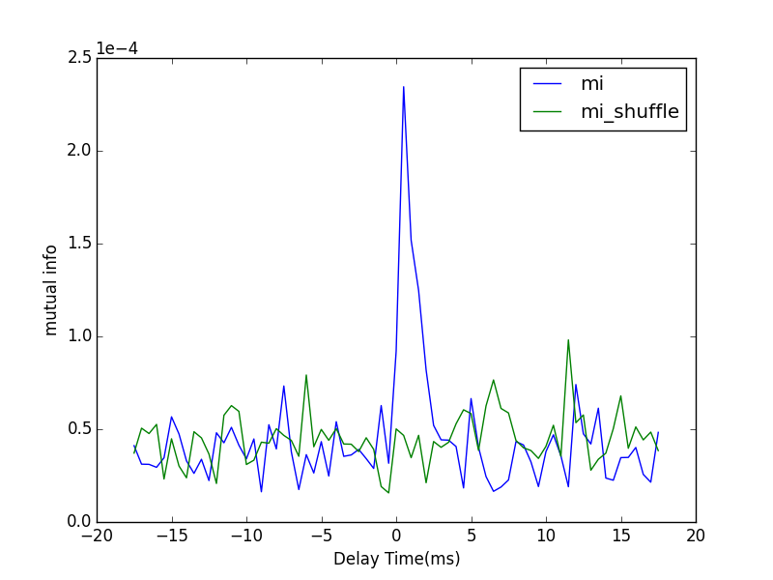
Robustness
Fix the product of Poisson driving rate and feedforward strength. Change the Poisson driving rate and investigate the change of mutual information pattern
1.5 kHz
0.15 kHz
0.1 kHz
dt | 0.5 ms
#bins | 20
T | 10 mins
Synaptic Strength | 0.005

Slide 17
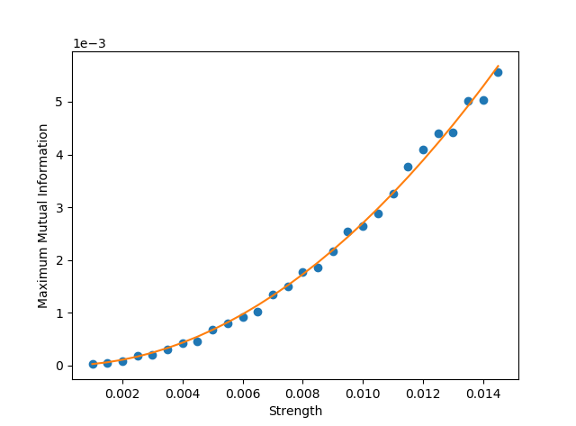
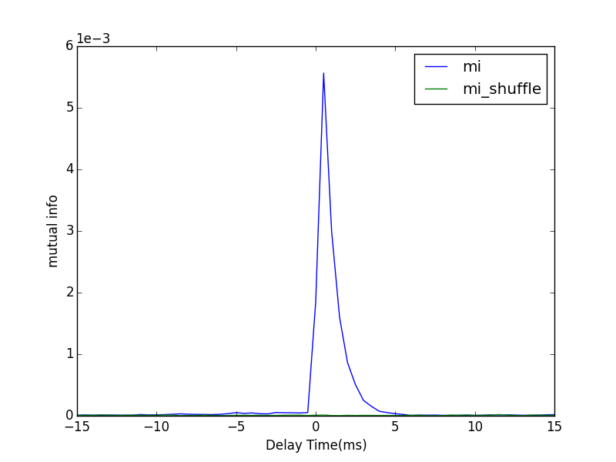
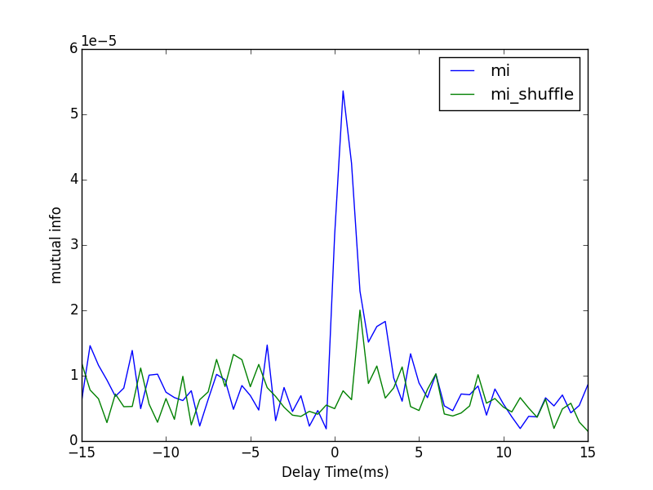
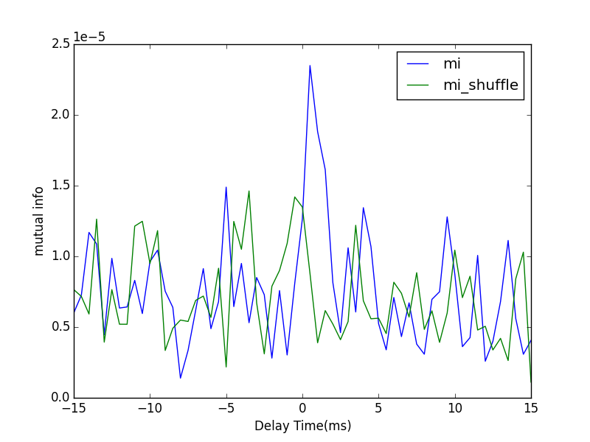

Direct calculation
Relation between synaptic strength and values of maximum mutual information
Synaptic strength ranging from 0.001 to 0.0145
Mean firing rate for presynaptic neuron is 25.5 Hz
Mean firing rate for postsynaptic neuron is ranging from 25.32 Hz to 28.06 Hz
dt | 0.5 ms
#bins | 10
T | 5 mins
$$MI=As^{2}$$

Slide 18
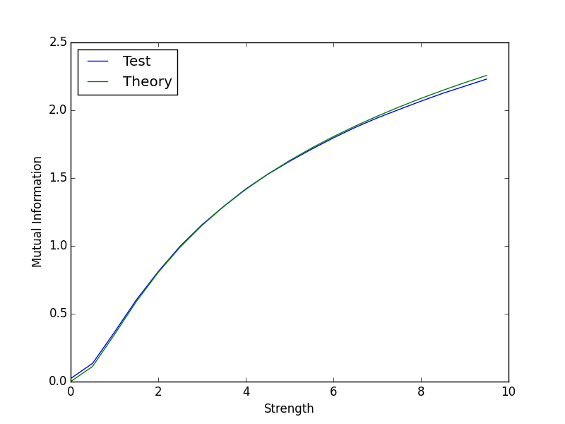
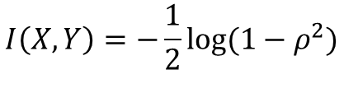




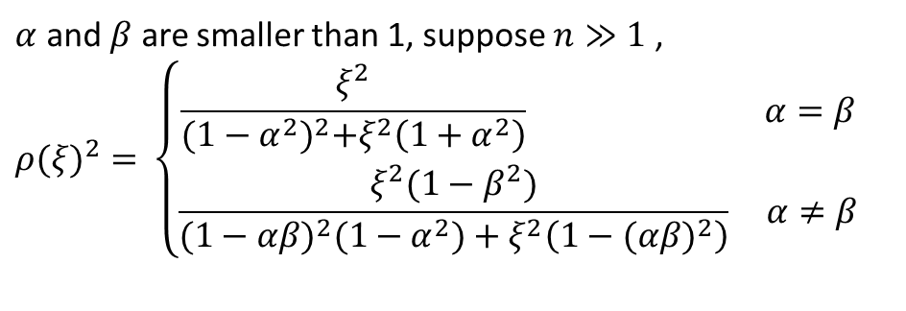

Mutual information of Gaussian random variables
$α=0.01，β=0.01$ #bin=50 T= 300000
$$X_{n}=αX_{n−1}+ε_{n}$$
$$Y_{n}=βY_{n−1}+ξX_{n−1}+η_{n}$$
$$I\left(X,Y\right)=H\left(X\right)+H\left(Y\right)−H(X,Y)$$
$$I\left(X,Y\right)=−\frac{1}{2}log⁡(1−ρ^{2})$$
$$ρ=ρ(ξ,α,β)$$
$α$ and $β$ are smaller than 1, suppose $n≫1$ ,
$${ρ(ξ)}^{2}=⁡\left\{\begin{aligned}\frac{ξ^{2}}{{(1−α^{2})}^{2}+ξ^{2}\left(1+α^{2}\right)} α=β \\ \frac{ξ^{2}(1−β^{2})}{{(1−αβ)}^{2}(1−α^{2})+ξ^{2}\left(1−{(αβ)}^{2}\right)} α≠β\end{aligned}\right.$$
#bins = 150 300000 trials

Slide 19
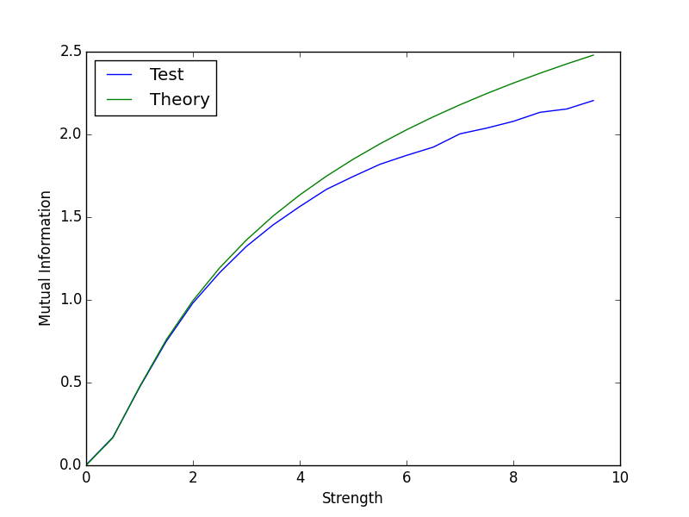
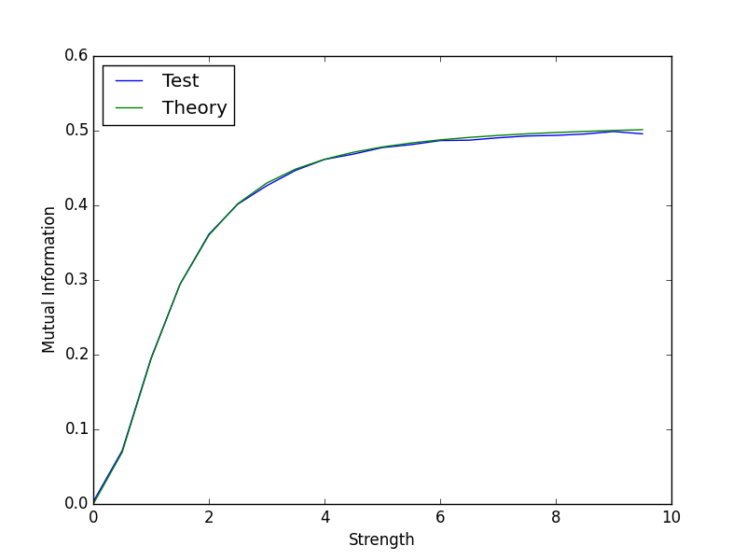
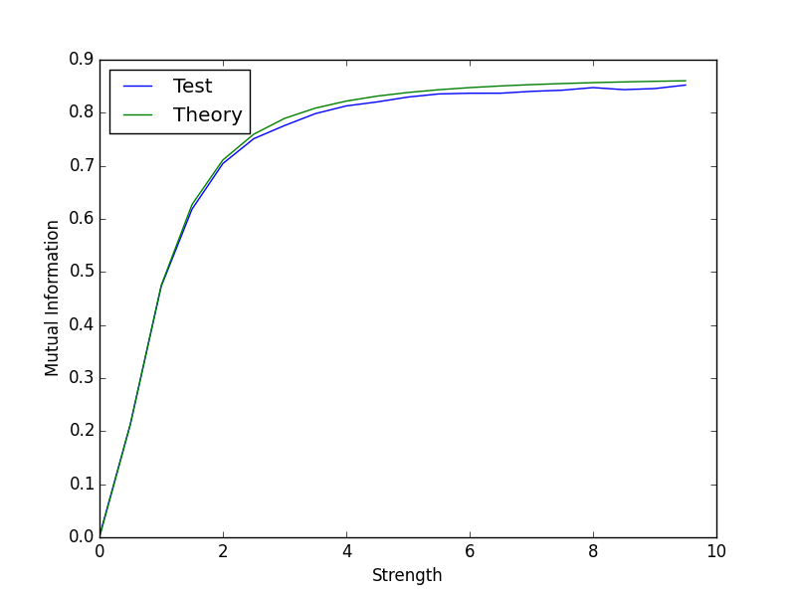
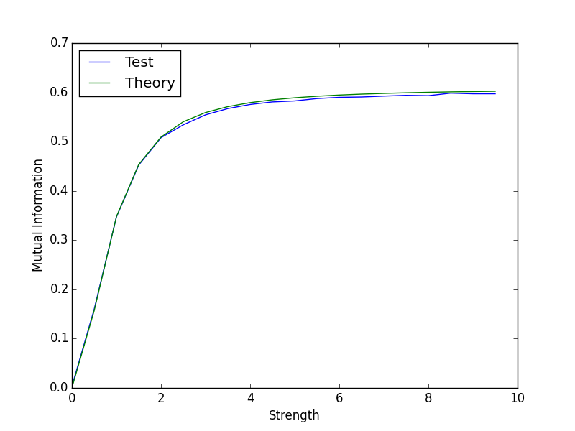




$α=0.6，β=0.01$ #bin=50 T= 300000
$α=0.01，β=0.6$ #bin=50 T= 300000
$α=0.6，β=0.5$ #bin=50 T= 300000
$α=0.5，β=0.6$ #bin=50 T= 300000

Slide 20
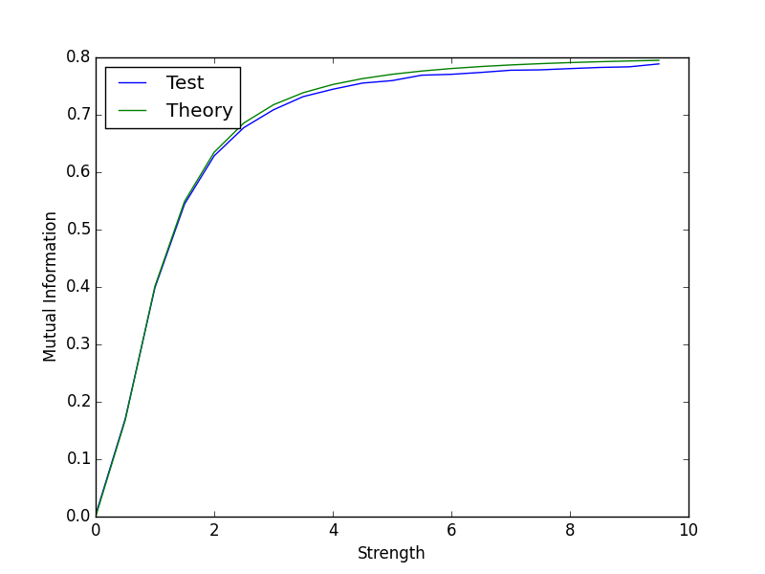

$α=0.5，β=0.5$ #bin=50 T= 300000

Slide 21
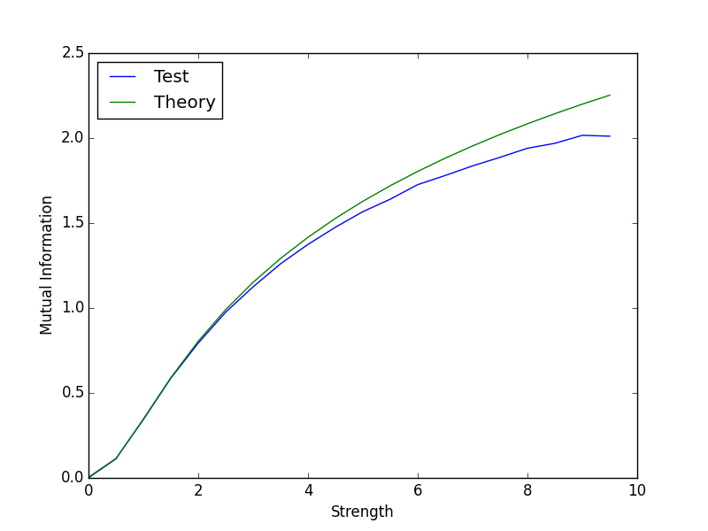

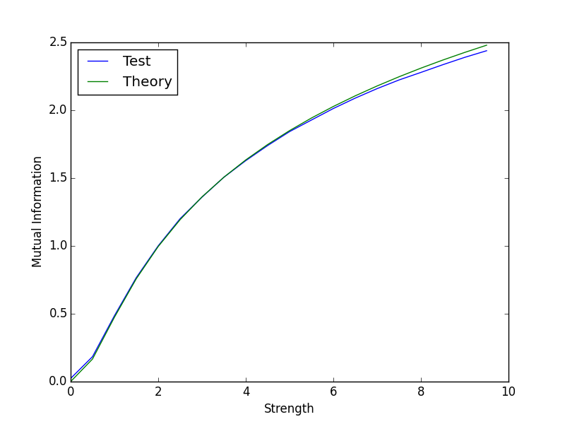




$α=0.01，β=0.01$ #bin=50 T= 300000
$α=0.01，β=0.01$ #bin=150 T= 300000
$α=0.6，β=0.01$ #bin=50 T= 300000
$α=0.6，β=0.01$ #bin=150 T= 300000

Slide 22
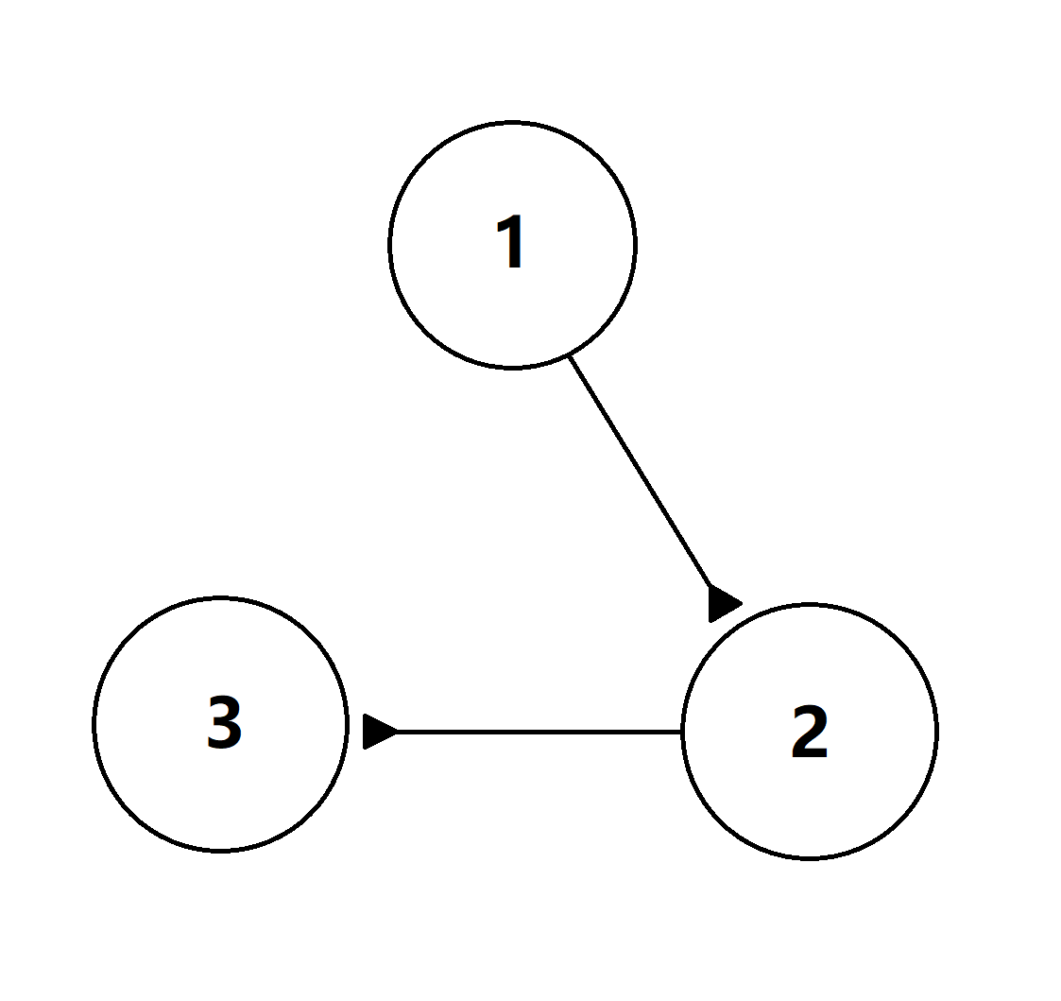
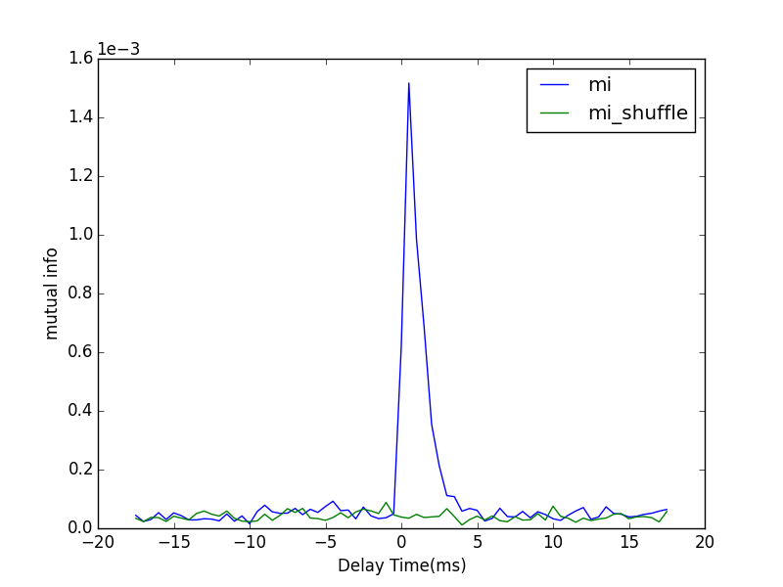
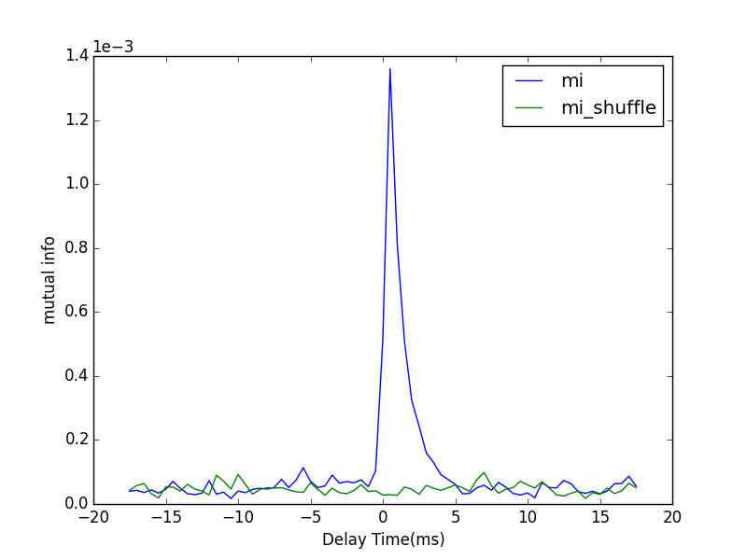
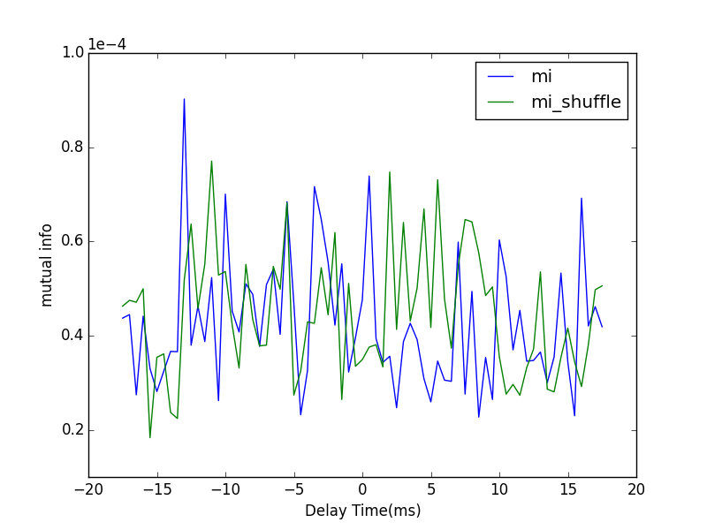
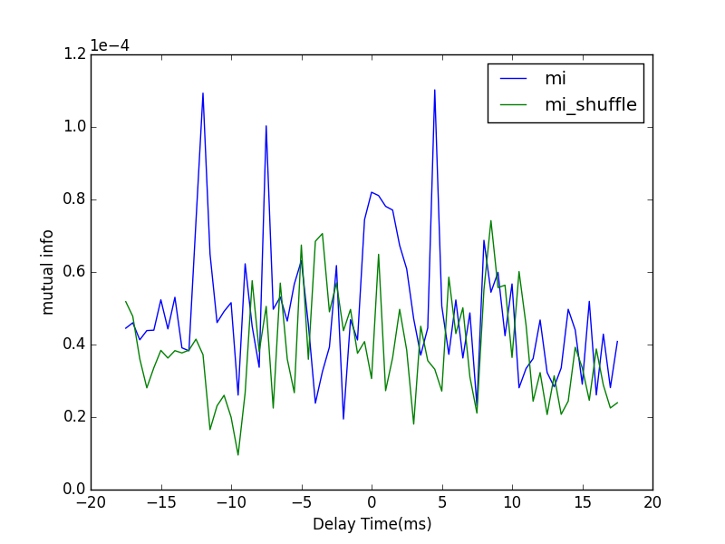


Triple-neuron system
1to2
2to3
1to3
2to1
3to2
3to1
Poisson Rate | 1.5 kHz
S | 0.005
F | 0.005
#bins | 20
T | 5 mins

Slide 23




Spike and voltage
1.5kHz
From 1 to 2
From 2 to 1
0.1kHz

Slide 24
Next Steps:
Take the dynamical properties of LFP into account. Up to current hypothesis and model of LFP, Synaptic current, neuronal morphology and dynamical states of local neuron population are three components that attributed to the mechanism of LFP.
How far at most the LFP spread in space can be captured by TDMI.
How does TDMI reflect the causal relation in different dynamical regime.

